Slide 1
Monolith to Microservices

Slide 2
Who are you?
Software Developer for > 20 years
Worked mainly for ISVs
Reuters, SunGard, Misys, Huddle
Worked for a couple of MIS departments
DTI, Beazley
Microsoft MVP for C#
Interested in OO, SOA, EDA,, Messaging, REST
Interested in Agile methodologies and practices
No smart guys
Just the guys in this room

Slide 3

Intelligent collaboration for the Enterprise

Slide 4
Agenda
Precursors
Assumptions
Making the case to Stakeholders
Business Capabilities
Bounded Contexts
Autonomous Components
Approaches
Rewrite
The Dangers of Going Dark
Strangler
Asset Capture
Event Interception
Reference Data
Building Planes in the Sky
Q&A (5 mins)

Slide 5
Precursors
Theory is continually the precursor of truth; we must pass through the twilight and its shade, to arrive at the full and perfect day.

Slide 6
Assumptions

Slide 7
We’re using Fowler and Lewis’s definition of a Microservice
Componentized via Services; Organized around Business Capabilities; Products not Projects; Smart Endpoints, Dumb Pipes; Decentralized Governance; Decentralized Data Management; Infrastructure Automation; Design for Failure; Evolutionary Design
By Monolith we mean an application that is integrated and deployed as a whole.
We don’t exclude distribution from a Monolith
A web application with browser, server, database, work queues etc. may be a monolith, if it must be integrated and deployed ‘as a whole’.

Slide 8
Making the case to Stakeholders

Slide 9

Increase Revenue Protect Revenue Reduce Costs

Slide 10
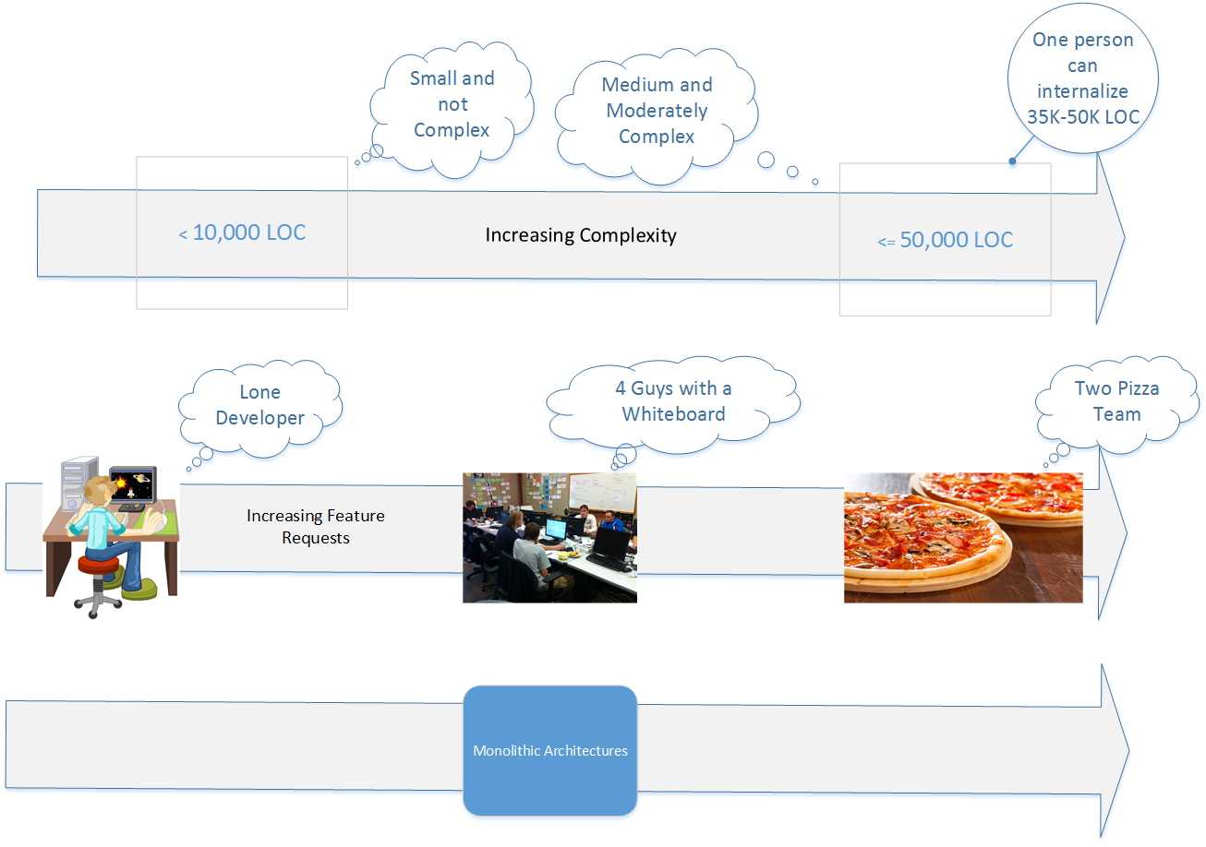

Slide 11
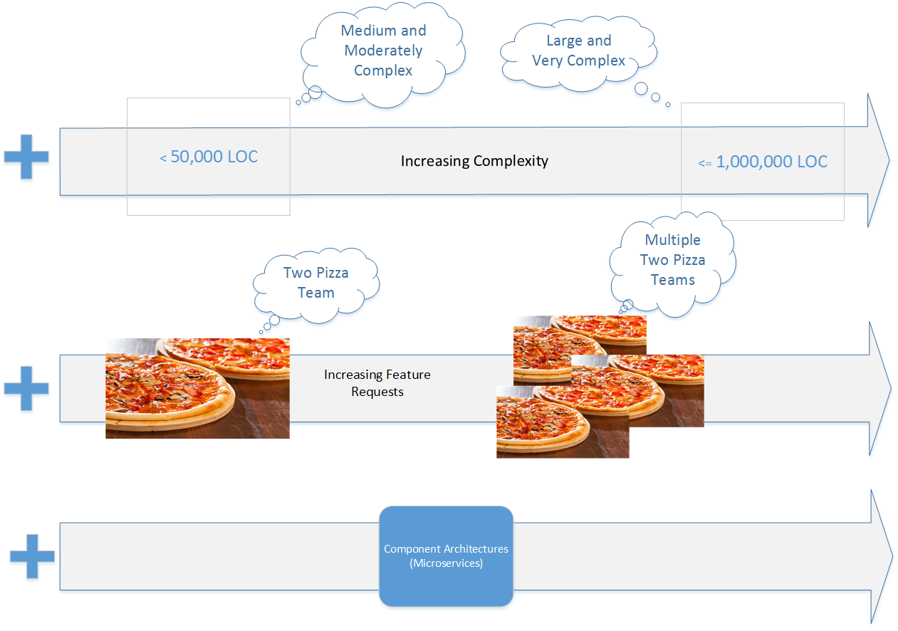

Slide 12
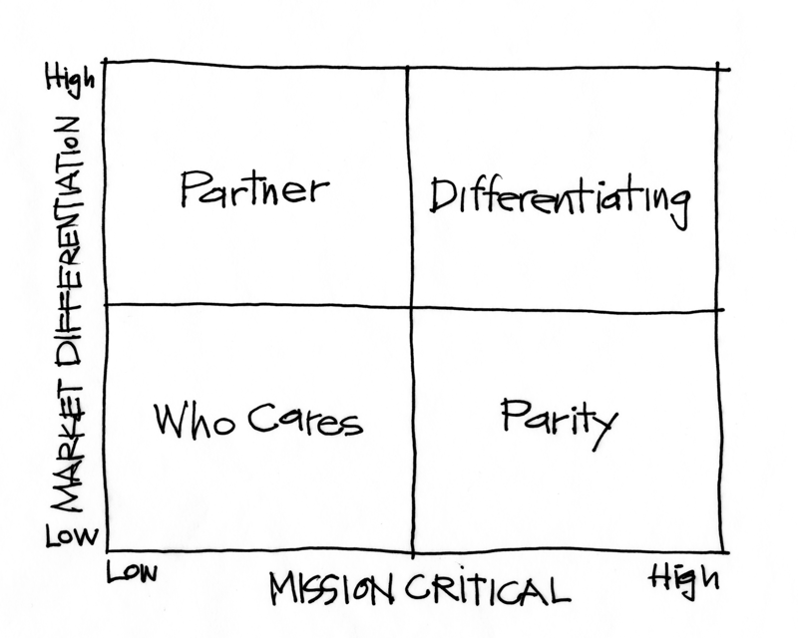
Purpose Alignment Model
Niel Nickolaisen created the Purpose Alignment Model. We compare how Mission Critical something is, against how Market Differentiating it is.
Differentiating – Clean Code, Now.
Parity – Good-enough software.
Partner – With a little help from my friends.
Who Cares – Shut it down, shut it down.
When moving to Microservices, evaluate the Product Alignment model. Turn some stuff off. Partner on other stuff. Accept Good Enough Software for much of it.
Lavish your attention where you are differentiating.

Slide 13
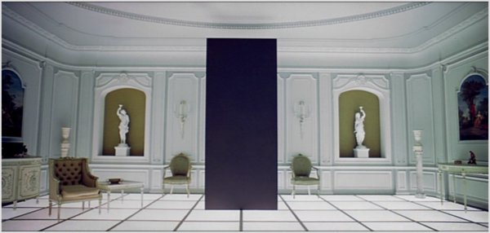
The Monolith may Endure
The Purpose Alignment Matrix gives you business priority.
First tackle those that will create the greatest cost reduction: the features that differentiate.
That means that some parts of your application: features that provide Parity or worse Who Cares will linger longer.
Who Cares requires stopping doing something, and so the pressure to resolve those features is low.
Partnering may take time.
You have to keep chipping away at the monolith, but it may endure alongside microservices for some time.

Slide 14
Business Capabilities

Slide 15
What is a Business Capability?
Motion Analysis (Microsoft)
We map capabilities at three levels, decomposing from top-to-bottom.
Level 1: Foundational Capabilities
Operational Capabilities
How we Deliver Service, Generate Demand, Create Products etc.
Environmental Capabilities
How we interact with Customers, Regulators etc.
Level 2: Capability Groups
Map to organizational accountability ownership
Claims, Underwriting, Housekeeping, Concierge
Level 3: Business Capabilities
Something the capability group does to provide value
Claims Assessment, Risk Rating, Room Service, Check-In
Level 3 is where we model services
A capability models what a business function does that provides value for customers – its externally visible behaviour and its service level expectations.
Rate Insurance Risk or Bill Customers are examples of business capabilities.
How people implement these, with people procedures and technology, is a business process.
A business consists of a network of interacting capabilities.
A capability is stable longer than a process.
As such we architect against capabilities not processes.
Microsoft Motion: https://msdn.microsoft.com/en-us/library/aa479368.aspx

Slide 16
Why care about capabilities?
Note though that it can be harder for product companies to envisage capabilities than enterprises.
You have to imagine the capabilities required by customers and how they fit within that.
In essence you need to define a persona for a customer, and reason about the capabilities that you offer them.
In B2B you need to reason about their capability map, and how you provide parts of it.
Business Capabilities are a high-level sketchy view. It’s useful, but it’s a first step in service implementation.
We need to transform these capabilities into something more concrete to define service boundaries.
Event Storming is one way to do this. We’ll talk about it more in Bounded Contexts but it gives us the communication flow between services.
Remember interactions are the focus.
We may chose to cluster business capabilities before transforming them into services.
A particular use case is where capabilities share a lot of private data. In this case it makes sense to group these into one service.
A capability is stable over a long time. Whilst the implementation may change because process is changeable the externally visible behaviour and service expectations remain stable.
The relationships between the capabilities are more important than the implementation of the capabilities over time.
The map of capabilities gives us a map of the business as interconnections between services, it also forms a foundation for the architecture of our software solution.

Slide 17
Bounded Contexts

Slide 18
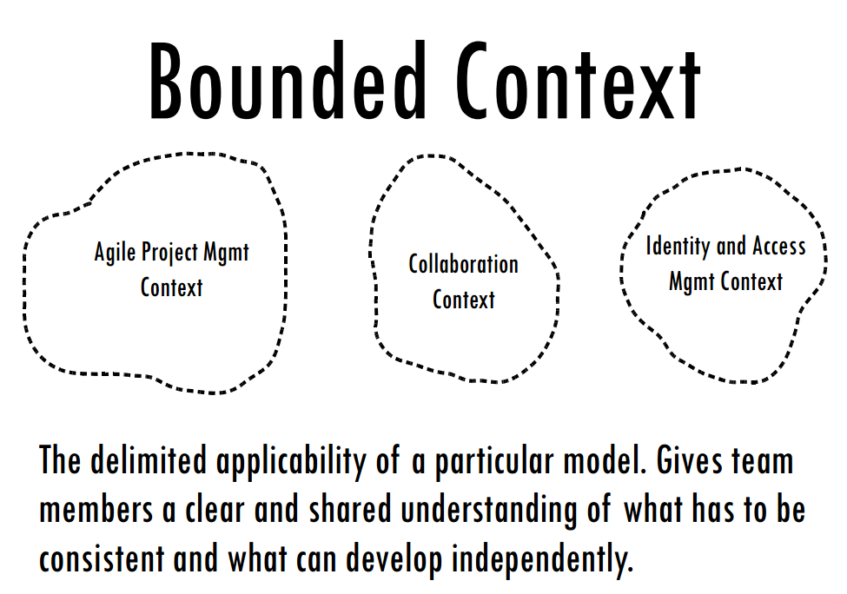
Bounded Context
Multiple models are often in play on a project
Seeking to combine or reconcile those models causes pain
Instead we limit our modeling of a domain to a context, often aligned with a business capability.
A domain model is only valid within that context
Terms of a ubiquitous language have meaning within a context
XP had a notion of metaphor for architecture, an idea that helped everyone envisage the domain.
Most folks just replace metaphor with ubiquitous language today
A Bounded Context is not a module
A Bounded Context is a CI boundary
Reference Data
Image from Vaughn Vernon, Implementing Domain Driven Design
Notes:
Multiple Models
Explicitly define the context within which a model applies. Explicitly set boundaries in terms of team organization, usage within specific parts of the application, and physical manifestations such as code bases and database schemas. Keep the model strictly consistent within these bounds, but don't be distracted or confused by issues outside.
When we talk about a ubiquitous language the terms only have meaning within a context. Thus the context is a linguistic boundary.
When we model use cases or scenarios, we will find it easier to model those elements, by CRC card sessions, or on the whiteboard, to restrict our discussion to one context. The classes that we define should deal with the problem context. They often do this naturally. Generally we build systems for requirements from one source, not from many. The attempt to model across requirements from different sources is what creates heartbreak from complexity – the canonical data model.
A context is analogous to the Single Responsibility Principle in OO. We want our objects to have only one reason to change. Multiple competing requirements from different context can cause an issue, because they create responsibilities for use cases that are widely divergent and thus lead us to have multiple sources of change.
For example, I once built an underwriting system that allowed user-definition of new products, where a product was essentially the data required for a pricing model for a selection of policy clauses that a business could purchase. This was modeled within the same context, underwriting as the workflow around a policy application – the principle being that all the choices on the product had relevance when processing the application. This proved problematic because the model to make the product user definable made it more complex than a static model, and the use cases were unrelated. It would have been better to have created a context for authoring products that could publish a product definition to underwriting, licensing and rating, instead of trying to create one that could be used by underwriting directly. The smell that rating and licensing required publication but that underwriting did not could have led to greater understanding here.
The party model is a classic example of an object that is designed for many contexts and thus has no meaning within any context.
Look for terms in the model that are not discussed with the domain experts – they are probably alien. Look for terms that are disagreed upon by domain experts: “you mean this, but I mean that” These are often a smell that the two domain experts care about separate contexts
BOUNDED CONTEXTS Are Not MODULES
The issues are confused sometimes, but these are different patterns with different motivations. True, when two sets of objects are recognized as making up different models, they are almost always placed in separate MODULES. Doing so does provide different name spaces (essential for different CONTEXTS) and some demarcation. But MODULES also organize the elements within one model; they don't necessarily communicate an intention to separate CONTEXTS. The separate name spaces that MODULES create within a BOUNDED CONTEXT actually make it harder to spot accidental model fragmentation.
A Bounded Context is a CI boundary
A bounded context is treated as a CI boundary, because we want the model to be consistent and not fragment
Within a bounded context we need: an automated build, automated test suites, continuous deployment
By implication – we do not need to do CI, automated testing, or continuous deployment across bounded contexts
A Bounded Context may be aligned with a Service
SOA boundaries are about business capabilities. A business capability tends to be aligned with the work of one department who have a shared understanding of model concepts. So in an insurance company Claims and Underwriting are separate departments with separate languages, and different use cases, so they have both differing models, but also tend to have separate business capabilities or services.
It may be more granular though. We may find that there are specialist areas of a business capability, such as rating within underwriting that might not be their own business capability – they don’t publish events to other Services for example – but are a separate context because their language and model is more specialized than the whole. We might find these are separate autonomous components within the logical service boundary, and have a separate set of use cases, hinting at their context.

Slide 19
Event Storming
Create a LARGE blank space
Identify Domain Events
Something of note that happens in the domain
Identify cause of event
A user: add a Command
Another system or time: Add a new External System event
Find Aggregates
An Aggregate transforms a Command or External System event into a Domain Event
At points of disagreement over the model, bounded contexts resolve conflicts as separate models.
A Business Capability is at least one Bounded Context. It may be more.
Identifying Bounded Contexts and Aggregates through Domain Events
An Aggregate is a transactional boundary (a coarse-grained lock).
We alert other Aggregates outside that boundary to the change by a Domain Event.
Aggregates responding to Domain Events are eventually consistent, not transactionally consistent.
So modelling Commands and Events lets us find Aggregates.
Alberto Brandolini: http://ziobrando.blogspot.fr/2013/11/introducing-event-storming.html

Slide 20
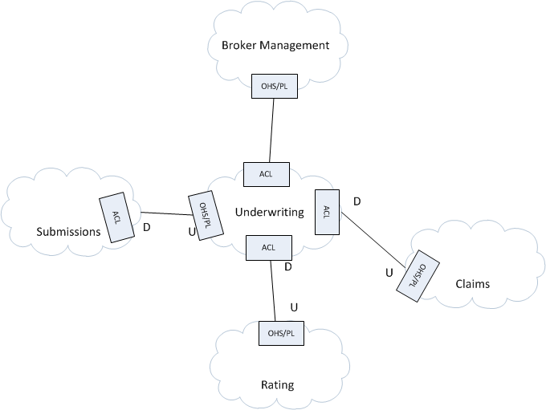
Context Mapping
Draw a context map of your existing system
A context map is things, as they are.
Although software follows team lines, and project managers exploit this to align sub-systems with teams, a context map makes these lines of communication apparent.
Teams are Customer and Supplier. One is Upstream, and the other is Downstream. Upstream teams must be constrained.
DDD provides a taxonomy of interaction styles.
An Anti-Corruption Layer (ACL) insulates one context from another.

Slide 21
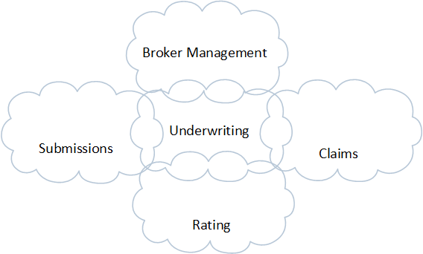
A Monolith has a Shared Kernel relationship
A Sharked Kernel says that two models share resources i.e. database schema, domain objects, etc.
As a result the CI boundary of a Shared Kernel is all of the bounded contexts that participate in the Shared Kernel.
A monolithic system is one in which multiple bounded contexts exist in a shared kernel – and thus have a single CI boundary and must be released together.
Even if we have modules or components, they are not autonomous as we must release together. This dependency across teams hampers delivery.
A Shared Kernel Context Map tells you what you need to break up!

Slide 22

Transformation
A context map is not fate. Transformations can move between an unmanageable map and a manageable one.
A transformation is not a refactoring, it is a project to tackle significant technical debt. It’s a debt restructuring programme.
Usual moves include:
Shared Kernel -> Customer-Supplier
Customer-Supplier -> Open Host Services
Open Host-Services -> Published Language
You can jump gaps, so Shared Kernel -> Published Language
These moves represent the heart of a monolith to microservices programme.

Slide 23
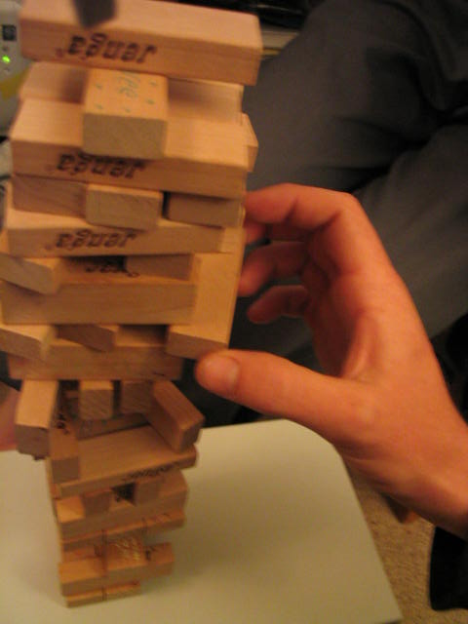
Single Bounded Context
Or Big Ball of Mud
It’s not uncommon of a monolith to have become a Big Ball of Mud. There is no separation of the model into differing Bounded Contexts. Everything is coupled to everything else, boundaries are unclear.
The first step is to break the system into a shared kernel. Identify candidate bounded contexts, separate common elements that cannot be factored out, from elements distinct to a context. These are the kernel.
Use an Anti-Corruption Layer to ring-fence clearly distinguishable bounded contexts from their neighbours to allow for extraction.
Start with the core domain, move according to value, be prepared for some rump to stubbornly persist where value of separation exceeded by cost.

Slide 24
Approaches
You need to study other people's work. Their approaches to problem solving and the tools they use give you a fresh way to look at your own work.

Slide 25
Rewrite
Growth of knowledge with big-bang integration
This option seems attractive, because it promises clean code.
If I have a Big Ball of Mud why bother trying to get it under control? Building an ACL to break my ball of mud up into separate bounded contexts is expensive and hard. Why do it?
Instead let’s build out better implementations of our bounded contexts.
Usually, I target these as replacing the full feature set of my existing application. At that point, I switch over.
The problem is this is a late learning, big bang strategy
cost
Knowledge comes at the “moment of truth”: final integration.
Delivers nearly no knowledge
(or risk reduction)
time
What Makes Agile Work, Alistair Cockburn

Slide 26

Going Dark
The other problem with a rewrite is going dark.
Whilst the business may be sympathetic to cost reduction goals of your microservices strategy, you are starving them of business value created through new features.
The usual pattern is that everything is fine for 6 months. People are excited about the change.
But the opportunity costs from lack of features mount up.
You can work in parallel, but then you are chasing a moving target. And you will always be behind.
Eventually the project is pulled, when you are partially complete, and not even complete enough to ship.

Slide 27
Strangler
Autonomy
The goal of strangling is to have a new Autonomous Component that has taken control of the Bounded Context from the legacy system.
You achieve Autonomy be receiving all the inputs and providing all the outputs for the Bounded Context. As you take control of the inputs and outputs the legacy application is slowly starved.
Eventually there is nothing left, the old code is as dead as it has no interactions.
Usually we find you get 80% of the way there by piecemeal strangling, then you need a push to clear the other 20%.
The key goal is usually to own all writes and reads to the Db tables we need to pluck from the monolith.
This option uses piecemeal replacement.
Assume that I have Features A-Z.
I can prioritize them in value using the Purpose Alignment Matrix.
Then I can replace them one at a time, until I have replaced all of my Features.
I avoid Going Dark, because I do this one Feature at a time.
You can use a rewrite strategy here: rewrite the feature to be strangled in clean code.
But this is doing two things at once. I prefer strangling until we get Autonomy and only then refactoring.

Slide 28
Managing Risk
Growth of knowledge with early, continuous integration
Walking Skeleton + Incremental Re-architecture
We manage risk of delivery on agile project through walking skeleton and incremental re-architecture.
The danger on a re-write is that we do not or cannot figure out how to deploy this strategy.
Instead we opt for a feature-parity release.
This pushes us into a waterfall risk profile.
Delivers knowledge
(risk reduction)
Development sequence
indifferent (with respect to knowledge)
cost
Applies to both
business ("lean startups")
& technical design
time
What Makes Agile Work, Alistair Cockburn

Slide 29
Asset Capture
Possible strategies:
Take control of the API
Especially if our service is headless.
Maybe owning an existing API or creating a new one.
In that case, as devices talk our hosting of the API, we drop calls to the legacy system.
Take control of events
We become the source of events for downstream systems; we consume events from others.
Other services begin to listen to us, not the legacy code base.
Take control at the UI (Web Pages)
Tends to require old & new UI
New page may be less functionally rich, requiring a user to ‘switch back’ for full functionality.
Can lead to us dropping unwanted UI features by finding as we strangle that they have few or no users.
Asset Capture is transferring ownership of your Bounded Context from one application to another.
We drift the term slightly to separate it in a Strangler approach to mean the part of the process that is not Event Interception.
So we use Asset Capture to mean taking control of the reads and writes of the assets we own.
Often during Asset Capture both systems are ‘live’ and updating the same database. The risk here is functional changes must happen on both sides.

Slide 30
Event Interception
Raise an event from one context for another.
How do we source these events?
Raise event directly from the legacy code
Often harder than it may seem, as there may be no suitable seam at which we can raise the event.
Use a trigger in the Db to raise the event
Easier if you are just building a table to expose as an atom feed; harder if you are using MoM
Poll the Audit Trail for events related to Entities
In essence your Audit Trail is an event stream for the entity. It may be possible to trawl it to pull out events that you can then send
The main issue is contention for the Audit table between a polling reader and writers. Requires you to consider issues like deadlock victim etc.
Why do we need Event Interception?
When multiple Bounded Contexts have a Shared Kernel, or we have a Singe Bounded Context it is easy to communicate events.
We may share tables in the Db, or we may make direct calls from objects that will be in one context in another system to objects that will be in another context.
We fix the former via Reference Data (although we may generate it from Event Interception).
We fix the latter by Event Interception.
HTTP/ATOM or MoM doesn’t matter, approach is the same.

Slide 31
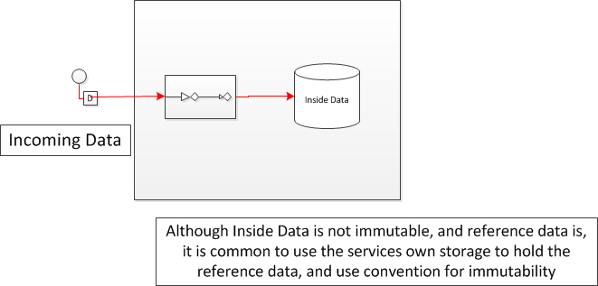
Event Driven Systems and Data Replication
Reference Data
Data on the Inside: Data encapsulated by a service
Data on the Outside: Data that the service chooses to share.
Operand data. Published in advance of other messages ‘operators’ that will use it i.e. a product list.
Historic Artifacts. The past of the sender, often a snapshot of some state i.e. a policy document from an underwriting platform to a claims platform.
Shared Collections. Held in common across multiple services. One service is the custodian i.e. customer data or employee data.
Use of reference data can alleviate availability issues of repeatedly calling another service to read its data.
(Source: Pat Helland, Data on the Outside vs. Data on the Inside)

Slide 32
Asset Capture
Monolith
Service
Cut & Shunt
Event Interception
Reference Data
Monolith
Data Autonomy
Files

Slide 33

Building Planes in the Sky
With infrastructure you have two choices:
Shut the infrastructure down whilst you replace it.
Keep the infrastructure working, whilst you replace it.
All too often this is osur only choice.

Slide 34
Q&A

